Slide 1



Airbus DS Catalogue Multi Engineering

Slide 2
EXECUTIVE SUMMARY

Slide 3
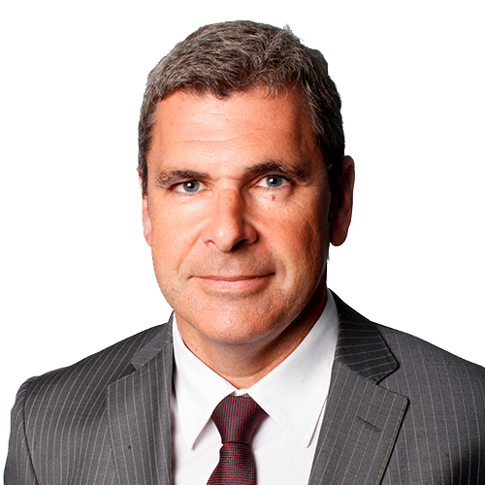
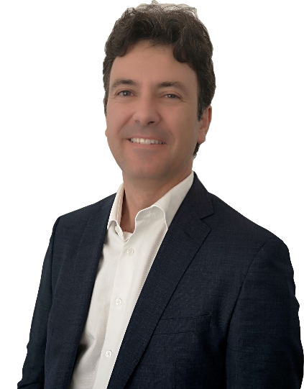
The ACME in the industry
“
The Aerospace and Defence market recently defined by the great and known company mergers is experiencing, although waiting for new programmes, a significant growth thanks to the increase of the defence spending of some of the world key countries.
In this context main OEMs make their CORE/CONTEXT analysis to identify areas and domains that provide them with differentiation and a strategy for its Supply Chain.
In this sense Airbus DS launches ACME, a programme to externalize part of its engineering pursuing to benefit from multicompetence teams and a deliverables oriented management. For the ALTRAN Group, ACME is undoubtedly one of the largest contract we have ever faced worldwide. In terms of volume, relevance of the activity and because it mainly encompasses two very important countries as Spain and Germany, ACME is a priority challenge for us and as such we dedicate a great effort to offer the service Airbus DS requires at all times.
Proof of this is also our R&D investments, completely aligned towards developing talent for the market as well as new technologies that could be applied, for example within this contract.
ALFONSO MARTÍNEZ
Aerospace Industry Senior VicePresident
”
ALTRAN´s strategy at an Airbus DS level
“
As many of our clients Airbus DS is facing challenges related Time-to-Market acceleration, be more innovative and digital as well as cultural changes to foster cooperation and build One Engineering organization. Our own strategy plan, High Road 2022 is designed to support our key clients as Airbus DS to achieve these goals.
Engineering domain is a cornerstone to face these challenges, and ACME the vehicle for Airbus DS partners to bring value in coming critical years. In this sense we highlight three axes of the Altran´s strategy for ACME:
First, keep improving our current performances based on our deep knowledge on Airbus DS products and services.
Second, contribute to foster transnational cooperation using our large international footprint.
Third, bring value through our high-value solutions based, for instead, on Analytics, IoT or Innovation and Design.
In short, we feel challenged and committed with Airbus DS goals for the coming years and are highly motivated to contribute to achieve these goals through ACME framework.
ALBERTO REGUERA
Global Account Manager for Airbus DS
”

Slide 4
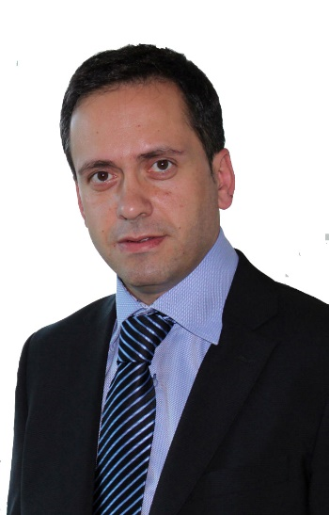

The main challenages ACME poses
“
ACME is a new way of working, more deliverable orientated, with a greater focus on objectives and results and with a commitment to quality that will be permanently measured with the corresponding indicators. Additionally, ACME will consolidate and reinforce the steps being taken towards working off-site and a greater autonomy on the supplier´s side. All of this will undoubtedly accentuate the added value offered by each company, demanding excellence in every step we take.
In this setting, the main challenges we face are organizational and change management. Working with WUs that are more focused on service, managing customer needs from an international level and finding more autonomous delivery modes are aspects that we have been working on for many years in Airbus Operations for example and from which we hope to apply our experience, lessons learned and good practices to ACME.
On the other hand, another challenge that we face is in the search for talent. In many cases the market is not capable of providing the specific knowledge required to meet the demand. ALTRAN has been working for a long time now with Internships, R&D and other initiatives in an attempt to mitigate this effect
.
LUIS JAVIER CODÓN
Managing Director Arospace & Defence Division
”
Our strategy on Alliances & Partnerships
“
Alliances & partnerships are key to serve our global and key accounts and are fully embedded into Altran´s strategy and supply chain.
As every customer has different needs Altran studies these in a careful way and answers with a customized approach for each client
We work with niche suppliers as well as capacity providers to complement our portfolio or domain know how to react on market needs and peaks and to enable End to End service offerings
In general, we only partner with companies that enrich our portfolio and boost our performance.
For the ACME we concentrate on established players that are working long-term in the aerospace and defence field to underline our ambition to bring value to Airbus DS and to support transformation as well as business continuity. With most of our partners we already work in MultiCo and MultiCeco or other environment for several years in a trustful way.
ALEX BÖDCHER
Managing director Aerospace & Defence Division
”

Slide 5
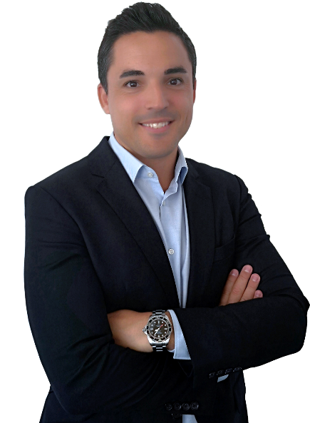
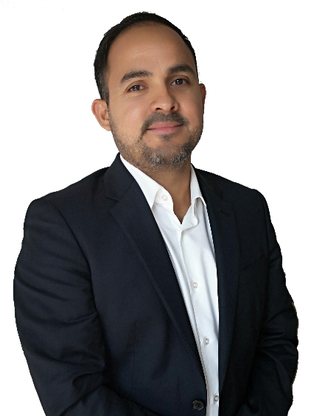
ALTRAN´s main objectives for this new period
“
First Deliver, this is the first and main goal of ALTRAN for this new contract. Everything else is a strategy or means to achieve it. We can never compromise this key parameter.
Beyond this we work towards offering more complete solutions, End to End, so that we consolidate the trust of our current customers, extend our footprint where we are not today and improve our on-going services. .For this we work every day to create customized solutions such as Critical SW, Cybersecurity and consolidate others such as the most established of System Integration or SW development or the most recent in Analytics or Innovation & Design.
We are a very large company, with great capacity, that structures its moving parts in such a way as to offer real added value to our customers. A great machine that on the other hand only sustains itself with GROWTH and therefore must be and will be another key objective of ALTRAN within the ACME.
In short, we want to become the principal and preferred partner for any Airbus DS activity within ACME.
.
GERMÁN BARBERO
Business Director Spain
”
What ALTRAN offers for the ACME
“
If I had to define aspects in which we believe and that I consider characterize us and therefore will be offered to Airbus DS in the coming years, they are commitment, flexibility and professionalism. ALTRAN is aligned with Airbus DS in the strategy it sets at all times.
We offer our experience for transnational collaborations, our extensive portfolio of expertise with our WCCs such as analytics or Innovation & Design, our skills development initiatives, and why not our best practices and lessons learnt regarding WUs catalogue management.
In Addition our Client knowledge allows us to be another defender of the Golden Rules, building fruitful and trustworthy relationships around Ethics and Compliance.
”
JUAN
BETHANCOURT
Business Director Germany

Slide 6

Our footprint after this period
“
As head of the Operations team, I would firstly want to look at the KPIs of each ACME service. I would like to see that each one is at its maximum potential, which means that our "First Deliver" goal has been achieved on time and with quality.
I would also like to see industrialization in our processes in order to be more efficient, so as to work as a real "Deliverable Factory" with greater autonomy and less need for client involvement. We have been working on this concept for some time now in the areas where it has been possible, trying to apply these practices for other clients such as Airbus Operations.
And of course I would love to see motivated teams that are continually striving for improvement, which characterizes the entire ALTRAN team.
”
EVA CESTEROS
Operations Director

Slide 7
ALTRAN GROUP

Slide 8





Altran is the global leader in the engineering and R&D industry
France
11,000
Europe
17,000
North America
1,600
Asia
14,000
MEA
1,500
7
WORLD CLASS CENTERS
80
NATIONALITIES
90%
ENGINEERS
EMPLOYEES 45,000+
15,000+ based
near and offshore
2017 REVENUES €2.9 BN
INTERNATIONAL
30+ Countries
INNOVATION
Over 30 Years

Slide 9
Leadership across 3 domains

Slide 10
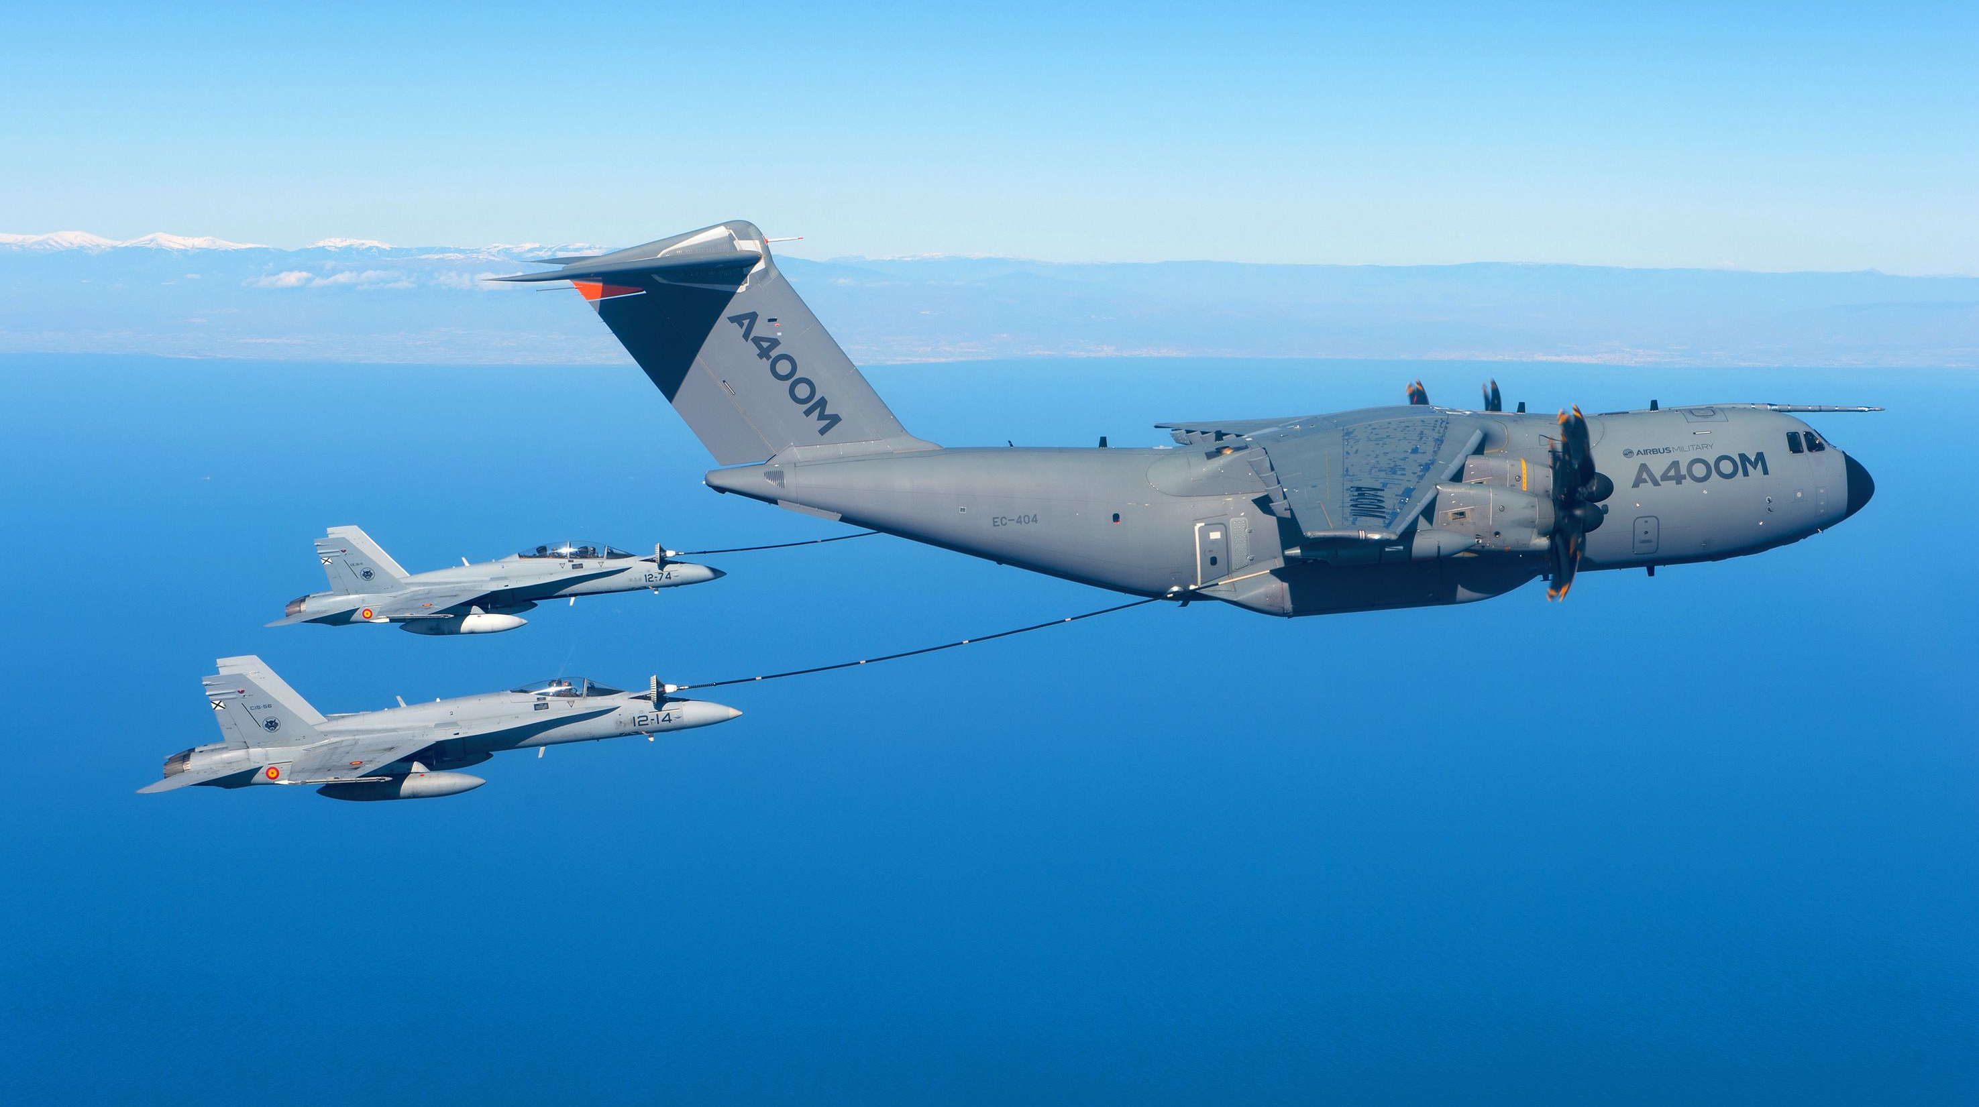
3 domains
Digital & Software
Product Design & Engineering
Manufacturing & Operations
10 Industries
10%
Finance &
Pubic Sector
17%
Automotive
Automotive
Aeronautics
Space, Defense & Naval
Railway, Infra & Transportation
Energy & Industrials
Life Sciences
Communications
Semiconductors & Electronics
Software & Internet
Finance & Public Sector
15%
Hi-tech &
Software
€2.9B
(proforma)
19%
Aerospace, Defence & Rail
21%
Telecom &
Media
18%
Energy, Industrials & Life Sciences
2017 ACTIVITY BREAKDOWN

Slide 11
Aeronautics, Space & Defense Industry
Altran Group & Airbus Group

Slide 12
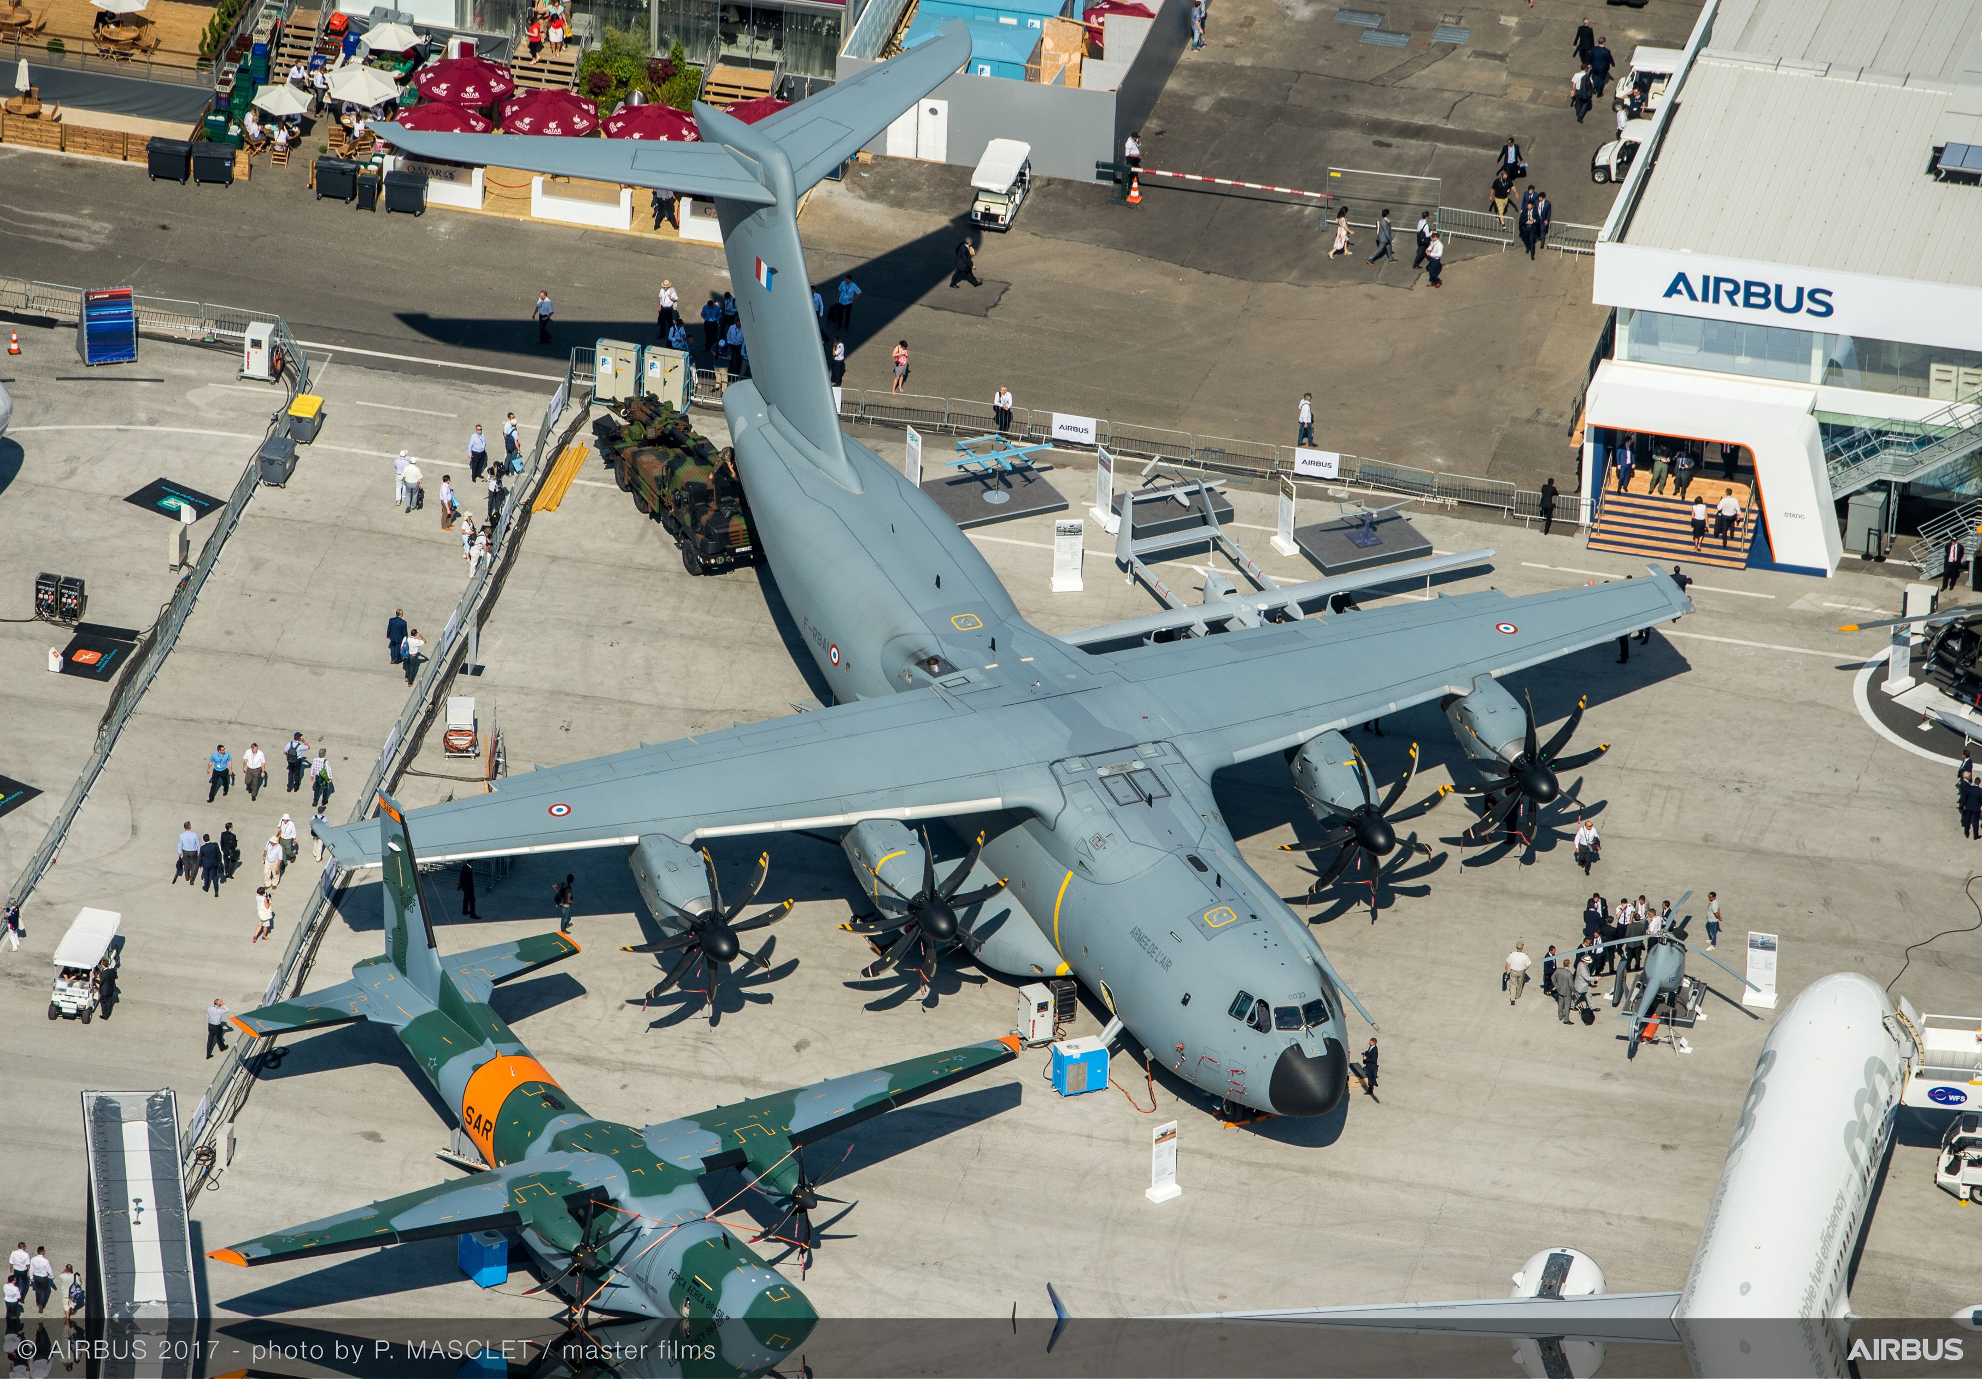
+
30 Years Presence in Aeronautics
5200 Dedicated Engineers
€ 475m 2017 turnover

Slide 13
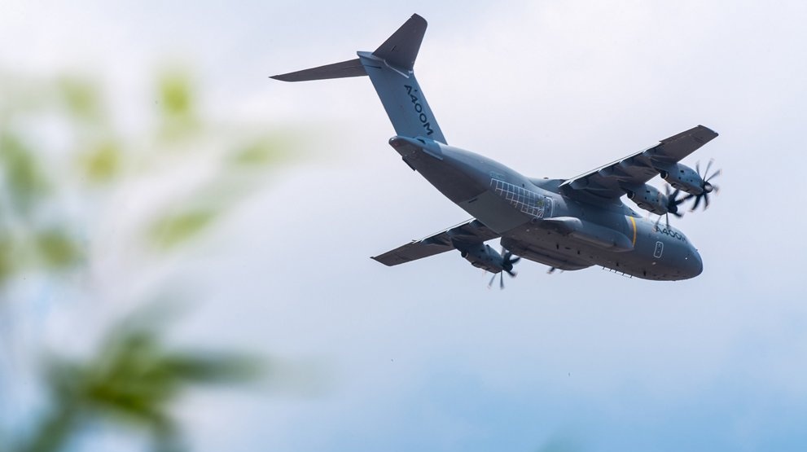
PREFERED SUPPLIER
E-Learning
E2S
R&T
Protospace
MAC IT
ME3S
Cyber
Ordering
QE
PMO
Actual Framework
New Framework
+
€ 250m REVENUES IN 2017
5 ACTIVE COUNTRIES
80 % Work Packages /Service Level Agreement

Slide 14
Altran Group & Airbus DS

Slide 15
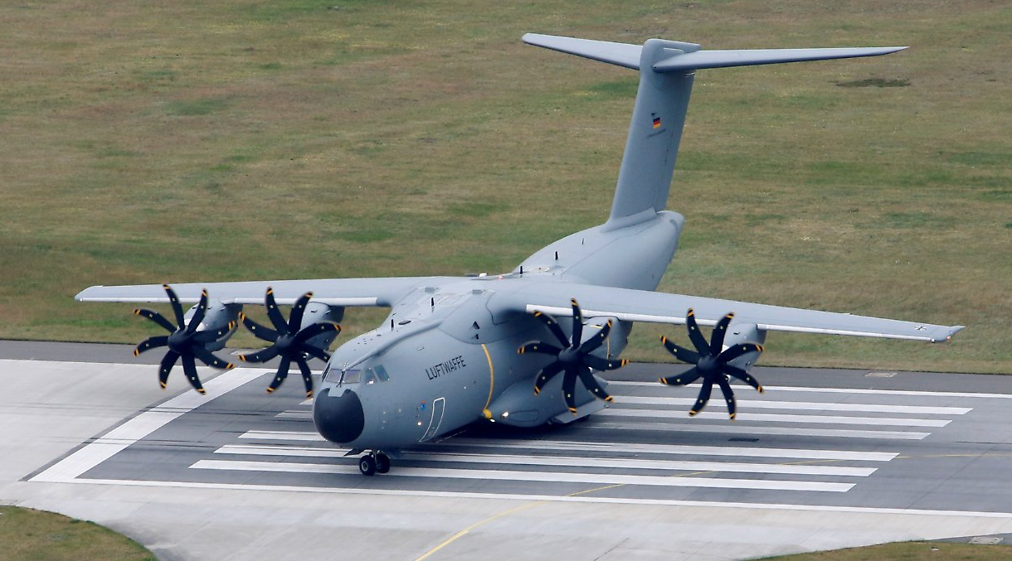
55M € REVENUES IN 2017 INVOLVEMENT IN MAJOR PROGRAMS
+ 4 ACTIVE COUNTRIES
WORK PACKAGES /SERVICE LEVEL AGREEMENT

Slide 16
Altran & Aricent

Slide 17

Altran and Aricent Creating the Global Leader in ER&D Services
Design-integrated engineering
Design the right thing + Engineer the thing right to bring intelligence to the experience
Aricent is a leading provider of ER&D services
- Global engineering services and design leader
- Key business differentiators:
. World class design and customer experience capabilities
. Deep expertise in key emerging technologies
. Scalable and industrialized delivery model
. Market leader in shaping transformational deals with clients
. Successful IP-based model
. Long-standing relationships with top technology market leaders
- Close to 70% of revenues in the North American market
- Strong leadership team with deep expertise and longstanding experience in large-scale organizations.
Altran ranks as the global leader in Engineering and R&D services (ER&D), following its acquisition of Aricent. The recent Aricent acquisition extends this leadership to semiconductors, digital experience and design innovation. Altran stands clearly at the forefront of this challenge, poised to sustainably set a new global standard for ER&D services. No other player can match the combined depth and range of services of Altran and Aricent.
Common
culture
With nearly 70% of its revenues from North America, Aricent is strongly rooted in dynamic markets: a powerfulcomplement to Altran’s strong European and Asian market positions. The combination of Altran and Aricent constitutes an unprecedented, truly global ER&D provider, with India as its largest single country in terms of employees and the US as its secondlargest source of revenue. Everyone within the new organization shares a common understanding of market dynamics and similar business culture. Together, all are ideally positioned to seize the unprecedented growth opportunities of the new industrial revolution.

Slide 18

Aricent A digital leader in design and engineering services
Aricent is a leading provider of ER&D services
Global engineering services and design leader
Key business differentiators:
World class design and customer experience capabilities
Deep expertise in key emerging technologies
Scalable and industrialized delivery model
Market leader in shaping transformational deals with clients
Successful IP-based model
Long-standing relationships with top technology market leaders
Close to 70% of revenues in the North American market
Strong leadership team with deep expertise and longstanding experience
in large-scale organizations
Global delivery model
24 engineering centers and design studios worldwide
Premier capabilities in India (8,500 engineers)
~10,500 employees of which:
~ 9,200 engineers
~ 600 designers

Slide 19
ALTRAN SPAIN
ALTRAN & AIRBUS GROUP IN SPAIN
ALTRAN & AIRBUS DS IN SPAIN

Slide 20
ALTRAN SPAIN
ALTRAN &
AIRBUS GROUP IN SPAIN
TURNOVER 2017
215m €
WORK PACKAGES/ SERVICE LEVEL
78%
TURNOVER 2017
45m €
EMPLOYEES 2017
3.600+
OFFICES
6 Headquarters
ALTRAN &
AIRBUS DS IN SPAIN
TURNOVER 2017
33m €

Slide 21
ALTRAN GERMANY
AERONAUTICS IN GERMANY
FIELDS OF COMPETENCE

Slide 22
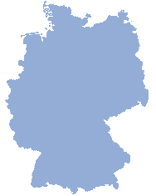
ALTRAN GERMANY
AERONAUTICS IN GERMNAY
TURNOVER 2017
275m €
DEDICATED ENGINEERS
+ 650
TURNOVER 2017
63m €
ENGINEERS
+ 3.200
PRESENCE
+25 Locations
FIELDS OF COMPETENCE
- Advanced aircraft development
- Production ramp-up processes & Industry 4.0
- Digital Services and Connectivity

